Slide 1
IE7275: Data Mining in Engineering
SUPERVISED MACHINE LEARNING Project
Topic: PDF MALWARE DETECTION
Team Members: Archit Raj | Raghav Kandpal
Presentation Date: 04/28/2022

Slide 2
Table of Content
01
Project Overview
04
Data Sources
Data Mining tasks
Insights of Decision Making
07
10
02
Problem Setting
Data Description
08
Data Mining Models/ Methods
Impact of Project Outcomes
05
11
03
Problem Definition
06
Data Exploration
09
Performance Evaluation

Slide 3
Project Overview
History:
Goal of the Project and Application of Machine Learning Model:
PDF, Portable Document Format, was created in 1990s by Adobe Systems.
Used to share documents, including text formatting and inline images
Mutually compatible and readable file type
Because of its inclusion of multimedia content embedded, there’s a high possibility of containment of malicious entity
Analyzing the collected pdf dataset
Applying the Data Mining techniques to understand the data trends between a malicious or benign pdf document.
Engineering the Supervised ML Model to quantify the results via previous patterns
Evaluation the performance of the ML model.

Slide 4
2. Problem Setting
What Exactly Is Happening?
Popularity of PDFs
One format can hold it all
Feasibility
Most reliable and preserves the document formatting
Hackers tend to utilize the advance features by embedding malicious threads to the PDf Documents
Target for hackers:

Slide 5
3. Problem Definition
OBJECTIVE
OUTCOME
Identify and Analyze
Predictions
Use concepts of Data Mining and Machine Learning to identify the best model classification from the dataset
To create predictors that will correctly detect whether a document is benign or contains malware

Slide 6

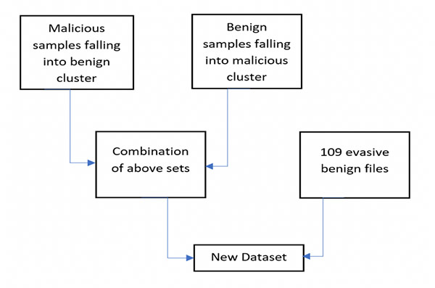
4. Data Sources
About the Data Source
Data Source
The dataset has been taken from the Evasive-PDFMal2022 created by The Canadian Institute of Cybersecurity at the University of New Brunswick in Fredericton
Process of Data Collection:
Link to the Data Source

Slide 7

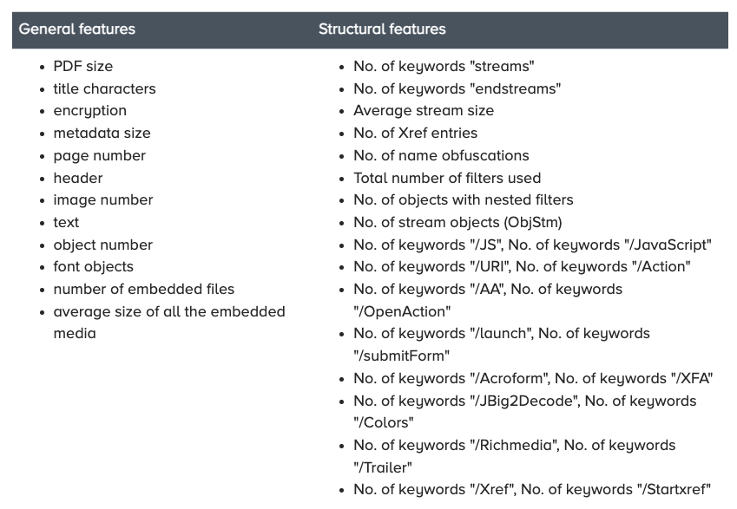
5. Data Description
Evasive - PDFMal2022
Analyzing
Data
Contains 10,025 records:
- 5,557 Malicious Records - 4,468 Benign Records
02

Slide 8
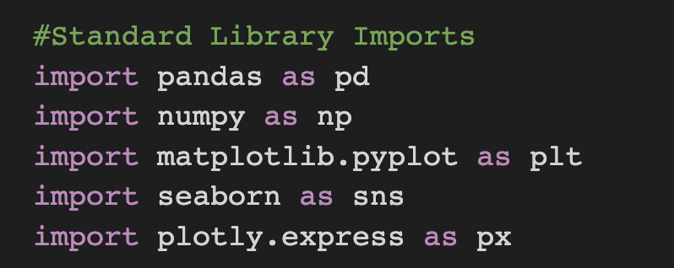
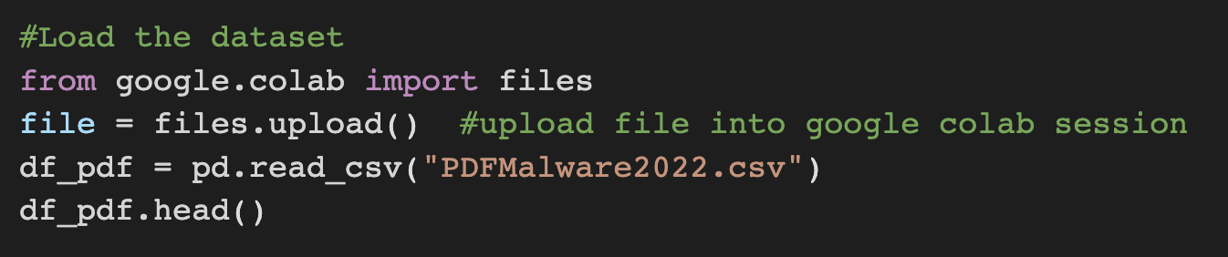
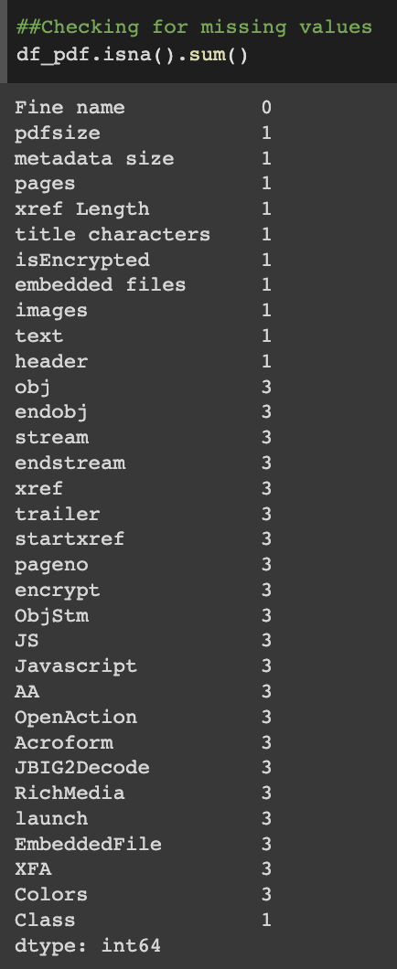
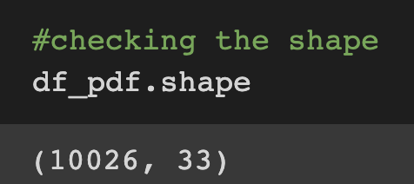
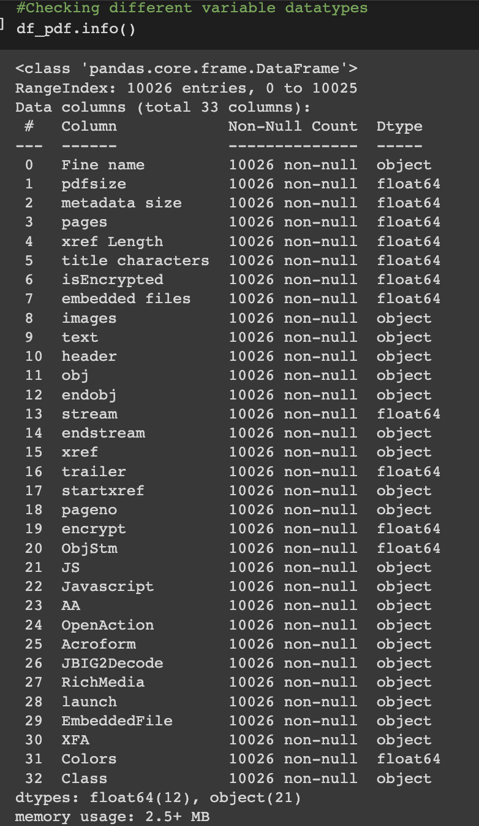
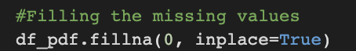
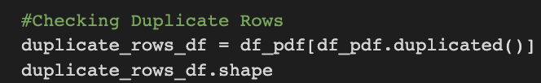
6.1. Data Exploration
Process Involved
Data Collection
B. Data Processing
01
01
Checking the Null Values using .isna().sum()
Importing the libraries and the PDFMalware.csv file on the data frame
02
Checked the dimension of variables
03
Checked the data types using .info()
02
Filling the missing values with 0s and removing duplicate values

Slide 9
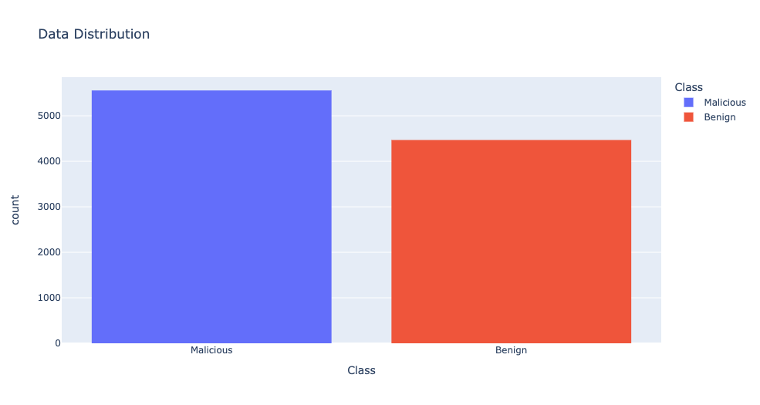
6.2. Data Exploration
Data Exploration
Target Variable:
02
Predictor Variables:
01
Malicious PDFs are given the target value 1.
Benign PDFs are assigned 0.

Slide 10
6.2. Data Exploration
PDF size: The malicious PDF size usually tends to vary from the benign due to its variation in page size and content.
Metadata size: It has a direct relation with the type of Class (Malicious or Benign). Metadata is the section where information about the PDF file is provided, which can be exploited for embedding hidden contents.
Document Encryption: This feature shows whether the PDF document is password protected or not.
Pages: Malicious PDF files tend to have fewer pages (most of them have one blank page) as they are not concerned about content presentation.
Text: Content presentation is not the objective of malware PDF files, they may include less text in their files.
Size: The malicious PDF size usually tends to vary from benign due to its variation in page size and content.
Embedded Files: PDFs are capable of attaching or embedding different types of files within themselves that might be used for exploitation, including other PDF files, doc files, images, etc.
Embedded media: The count of Embedded files in the PDF might lead to an insight into the content of the embedded files.
Objects Count: As PDFs are made of objects, the number of objects combined with the rest of the features can represent the PDF in general.
Count of font objects: Font objects indicate the types of fonts used for the PDF text.
PDF Header: As PDF header obscure is common for evading anti-virus scans, malicious PDF files tend to modify the header format.
Image: PDF files may contain one or any number of images.
03
Facts to be Considered:

Slide 11
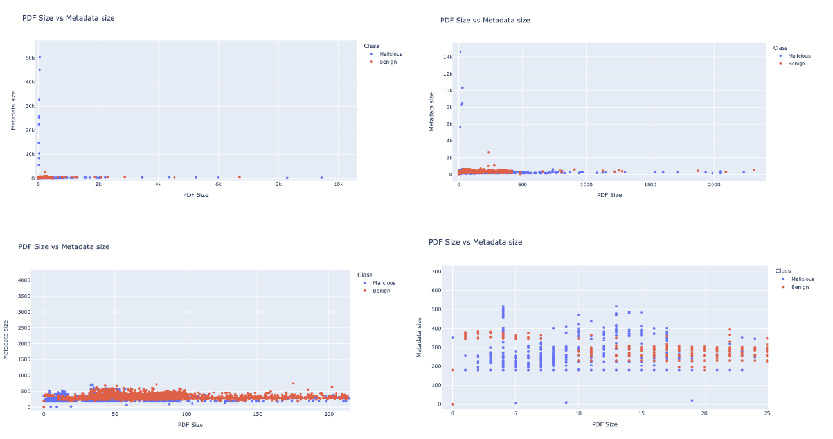
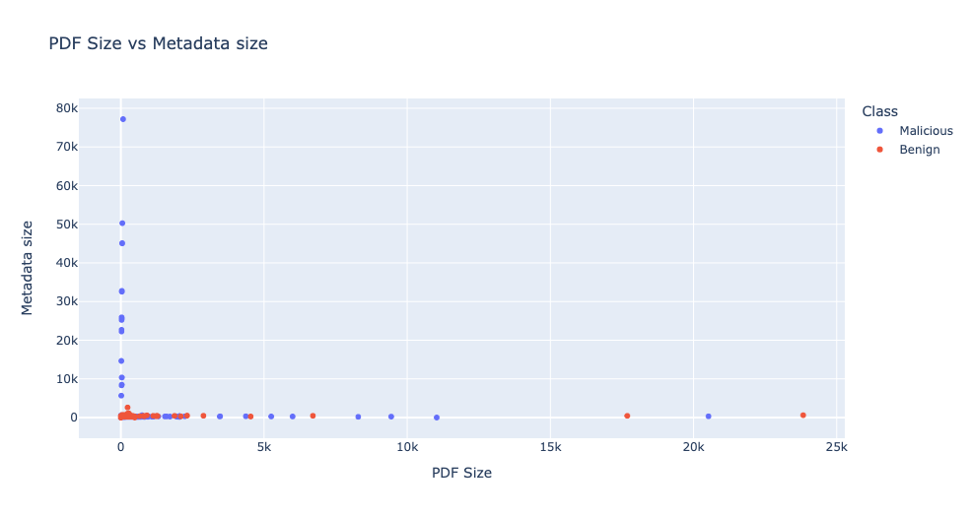
7.1. Data Mining Tasks
Data Visualization:
(With the help of Python’s Seaborn and Plotly libraries)
1. Class Distribution:
The distribution of class is checked to ensure the set to be somewhat balanced.
2. Scatter Plot:

Slide 12
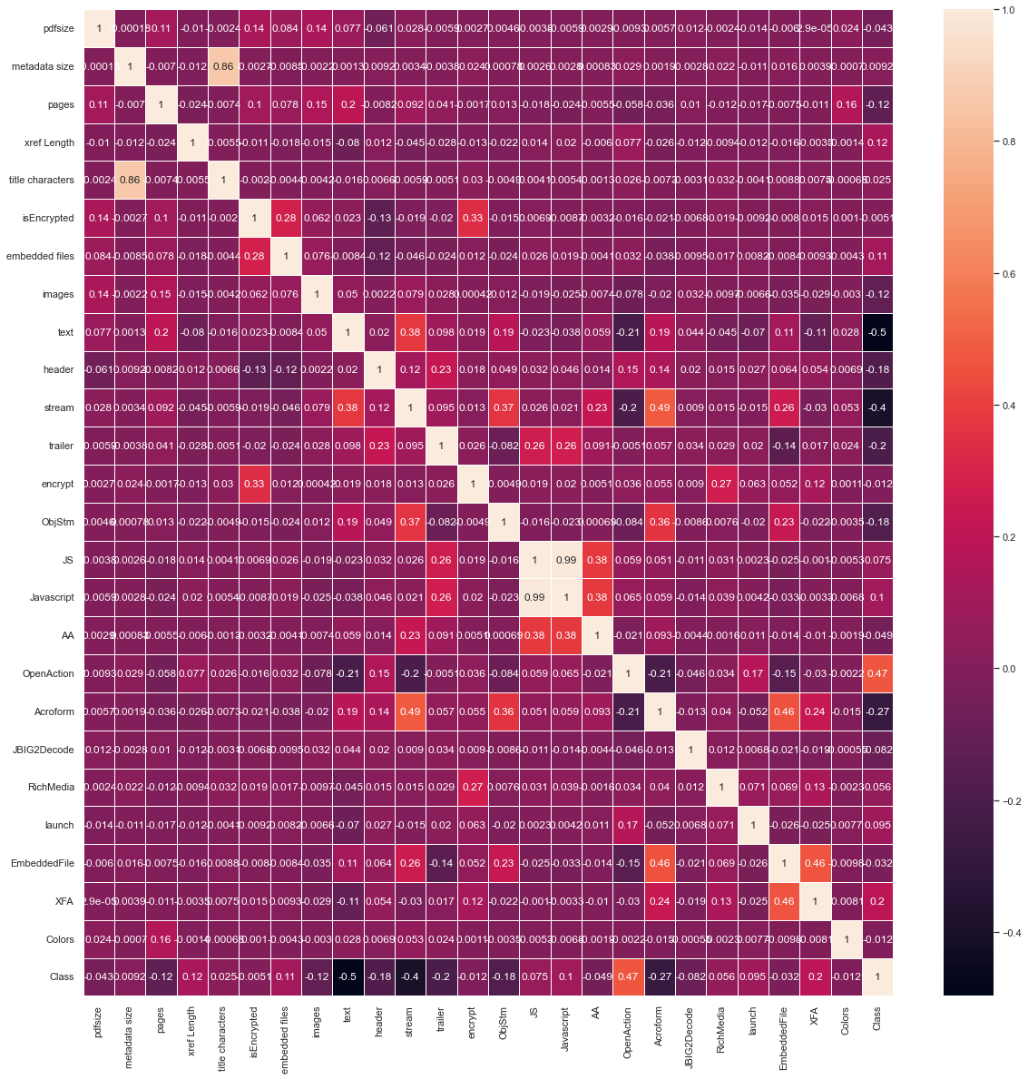
7.2. Data Mining Tasks
Data Visualization:
(With the help of Python’s Seaborn and Plotly libraries)
3. Correlation Plot
Correlation Plot between all the numerical variables.
Javascript and JS are redundant features.
Metadata Size and Number of Title Characters are highly positively correlated (0.86).

Slide 13
8. Data Mining Models/ Methods
8.1. Model Selection
Given that this is a classification task, we need to select the best classifier model in order to get a better overall accuracy score. We have narrowed down the candidates for the best model to:
Logistic Regression
k-nearest Neighbors
SVM Classifier
Predictor Variables
Response Variable
We will fit the training data to each of these models and select the one that gives the best accuracy score.

Slide 14
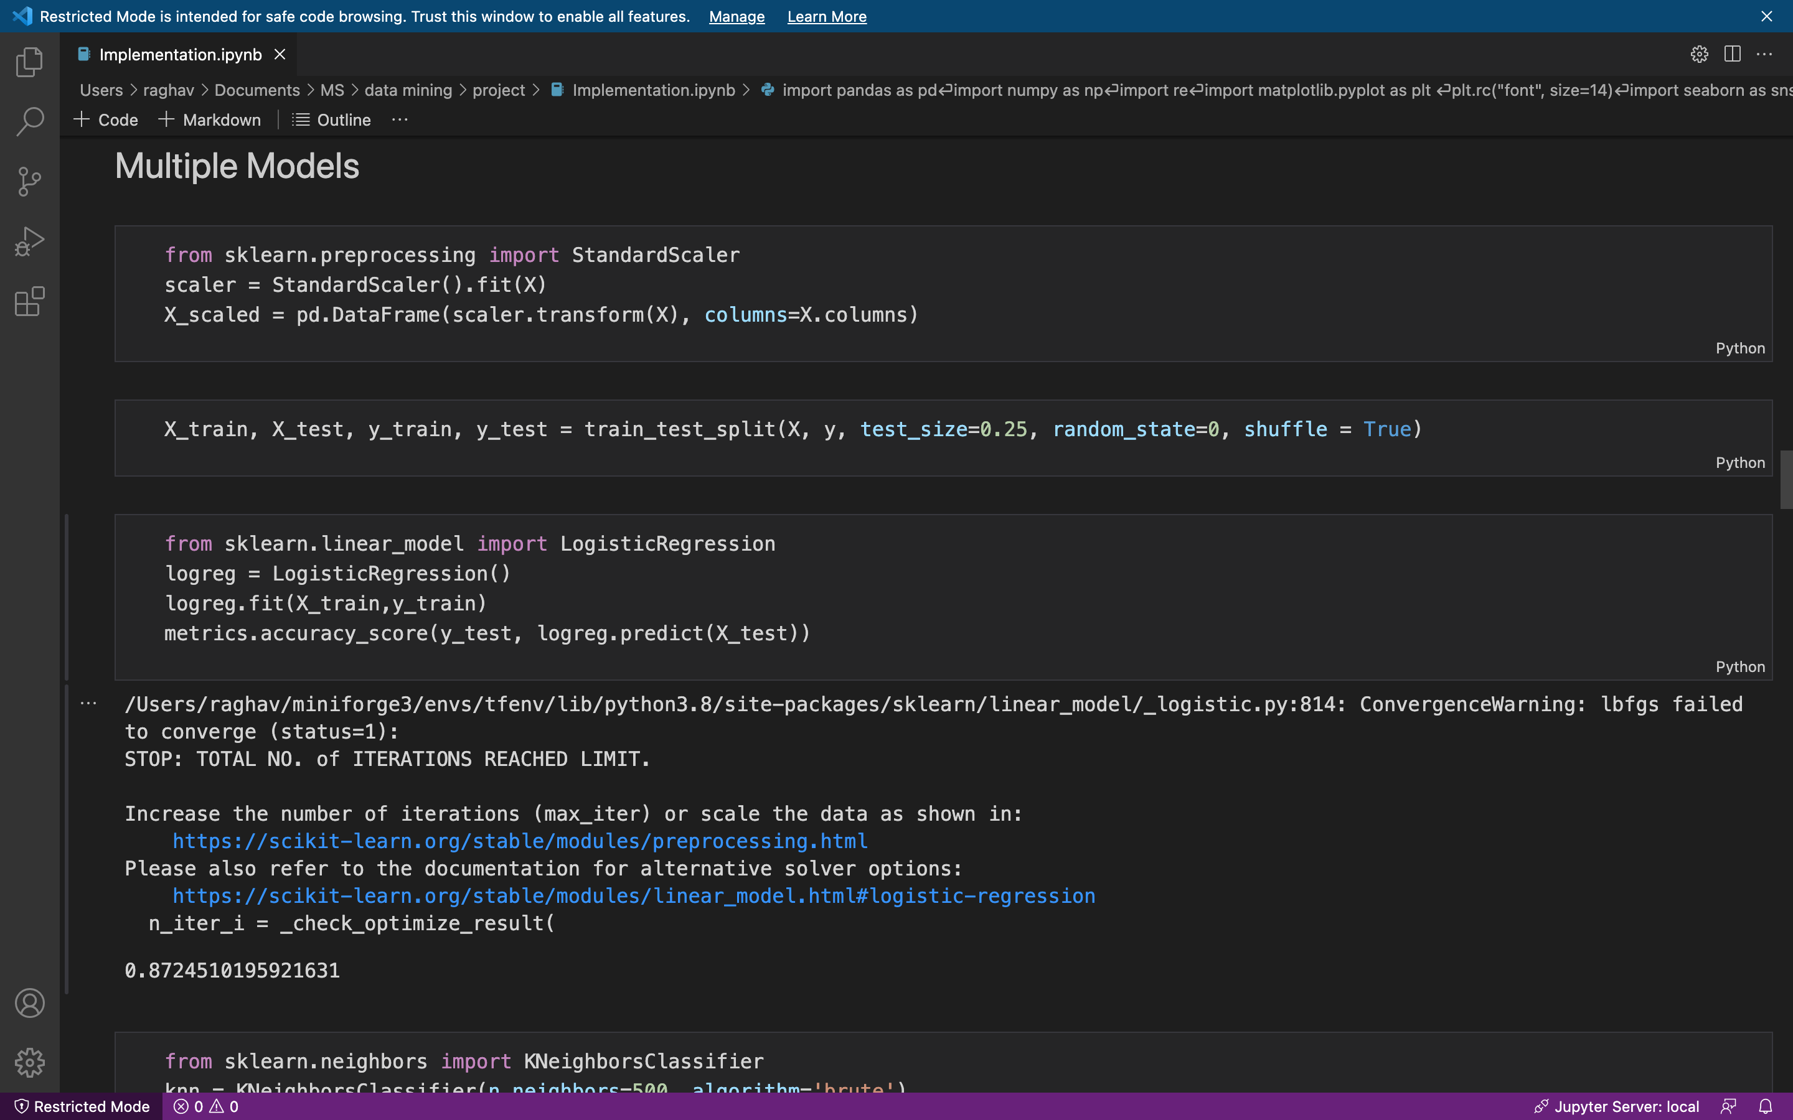
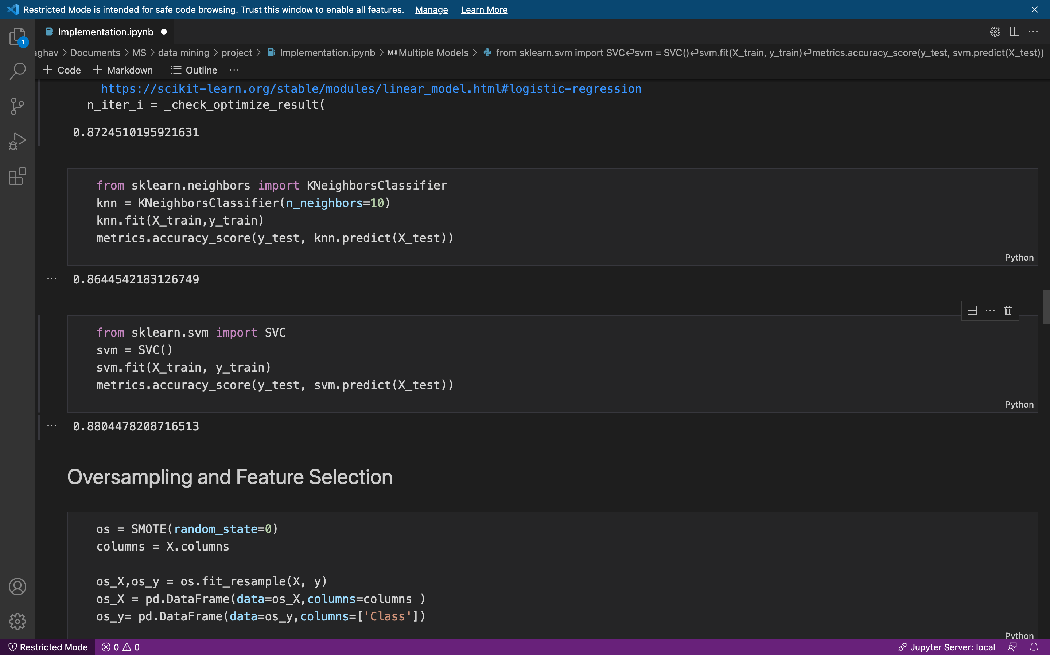
8. Data Mining Models/ Methods
8.1. Model Selection
Logistic Regression
01
Accuracy Score: 0.87245
Given the accuracy scores,
SVM Classifier comes out on top.
K-Nearest Neighbors
02
Accuracy Score: 0.86445
Support Vector Classifier
03
Accuracy Score: 0.88044

Slide 15
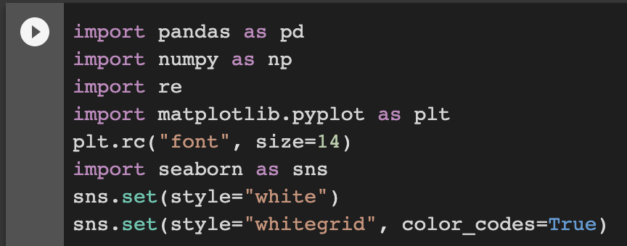
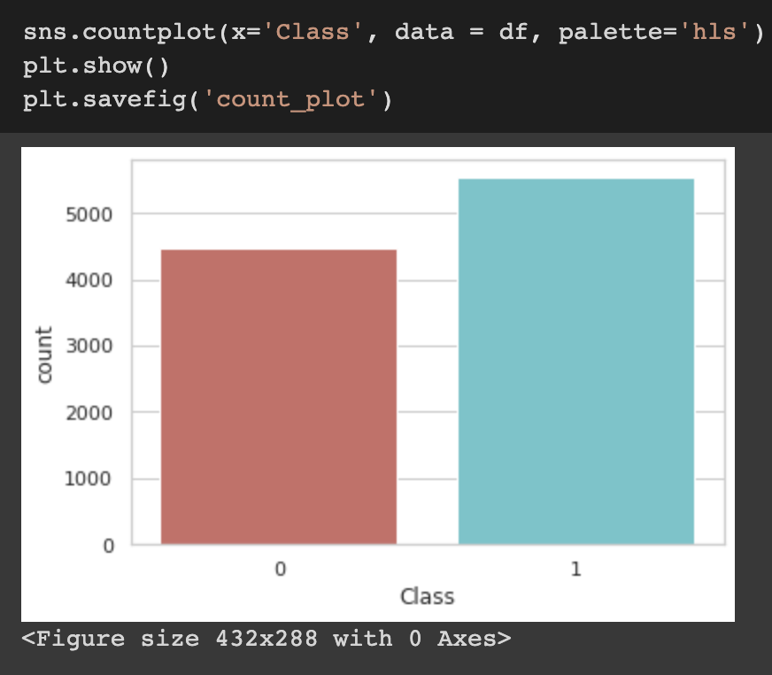
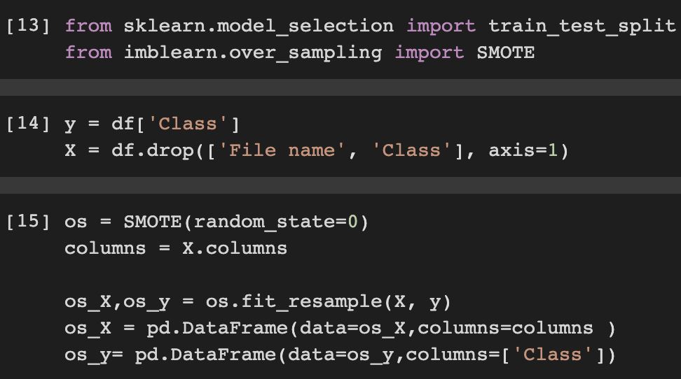
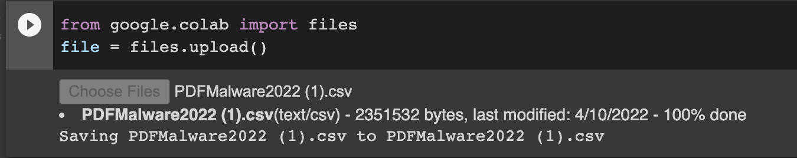
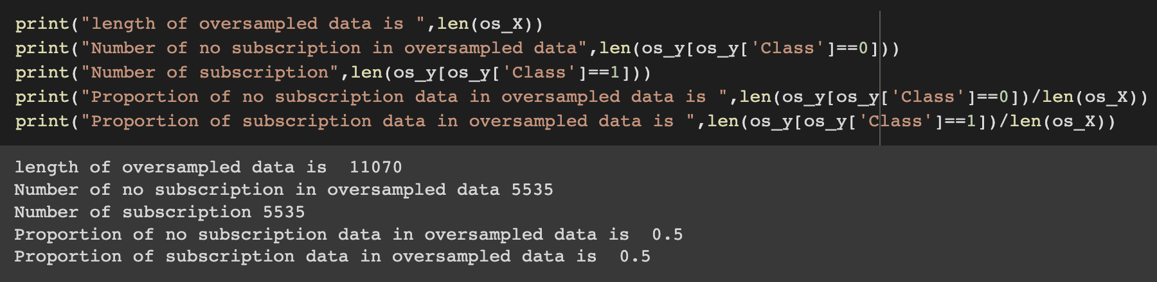
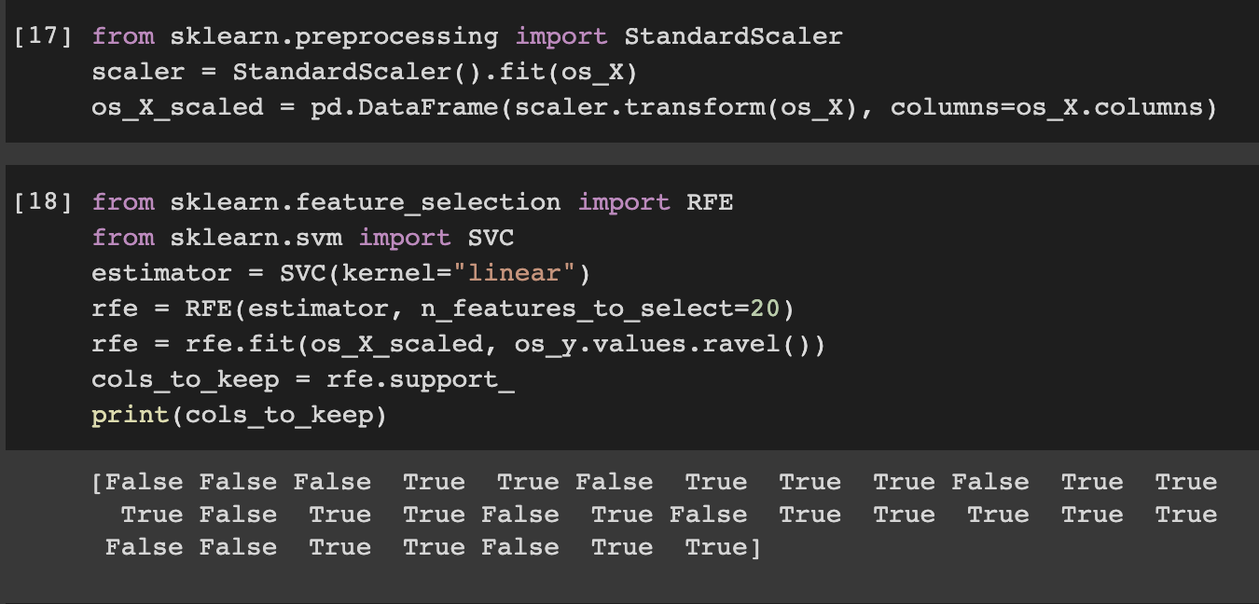
9. Performance Evaluation
9.1. Implementation of Selected Model: SVM
Continued
Importing the libraries & dataset
01
Creating the histogram to check the proportion of Malicious(1) and Benign file type using Seaborn library(0)
02
Splitting the data into train and test using SMOTE technique
04
06
05
Used Standard Scalar in order to fit the Oversampled data and utilized Recursive Feature Elimination algorithm to test the accuracy
Checked the size of Oversampled data, Num of No Subscription in Oversampled Data, Proportion of Subscription and No Subscription Data

Slide 16
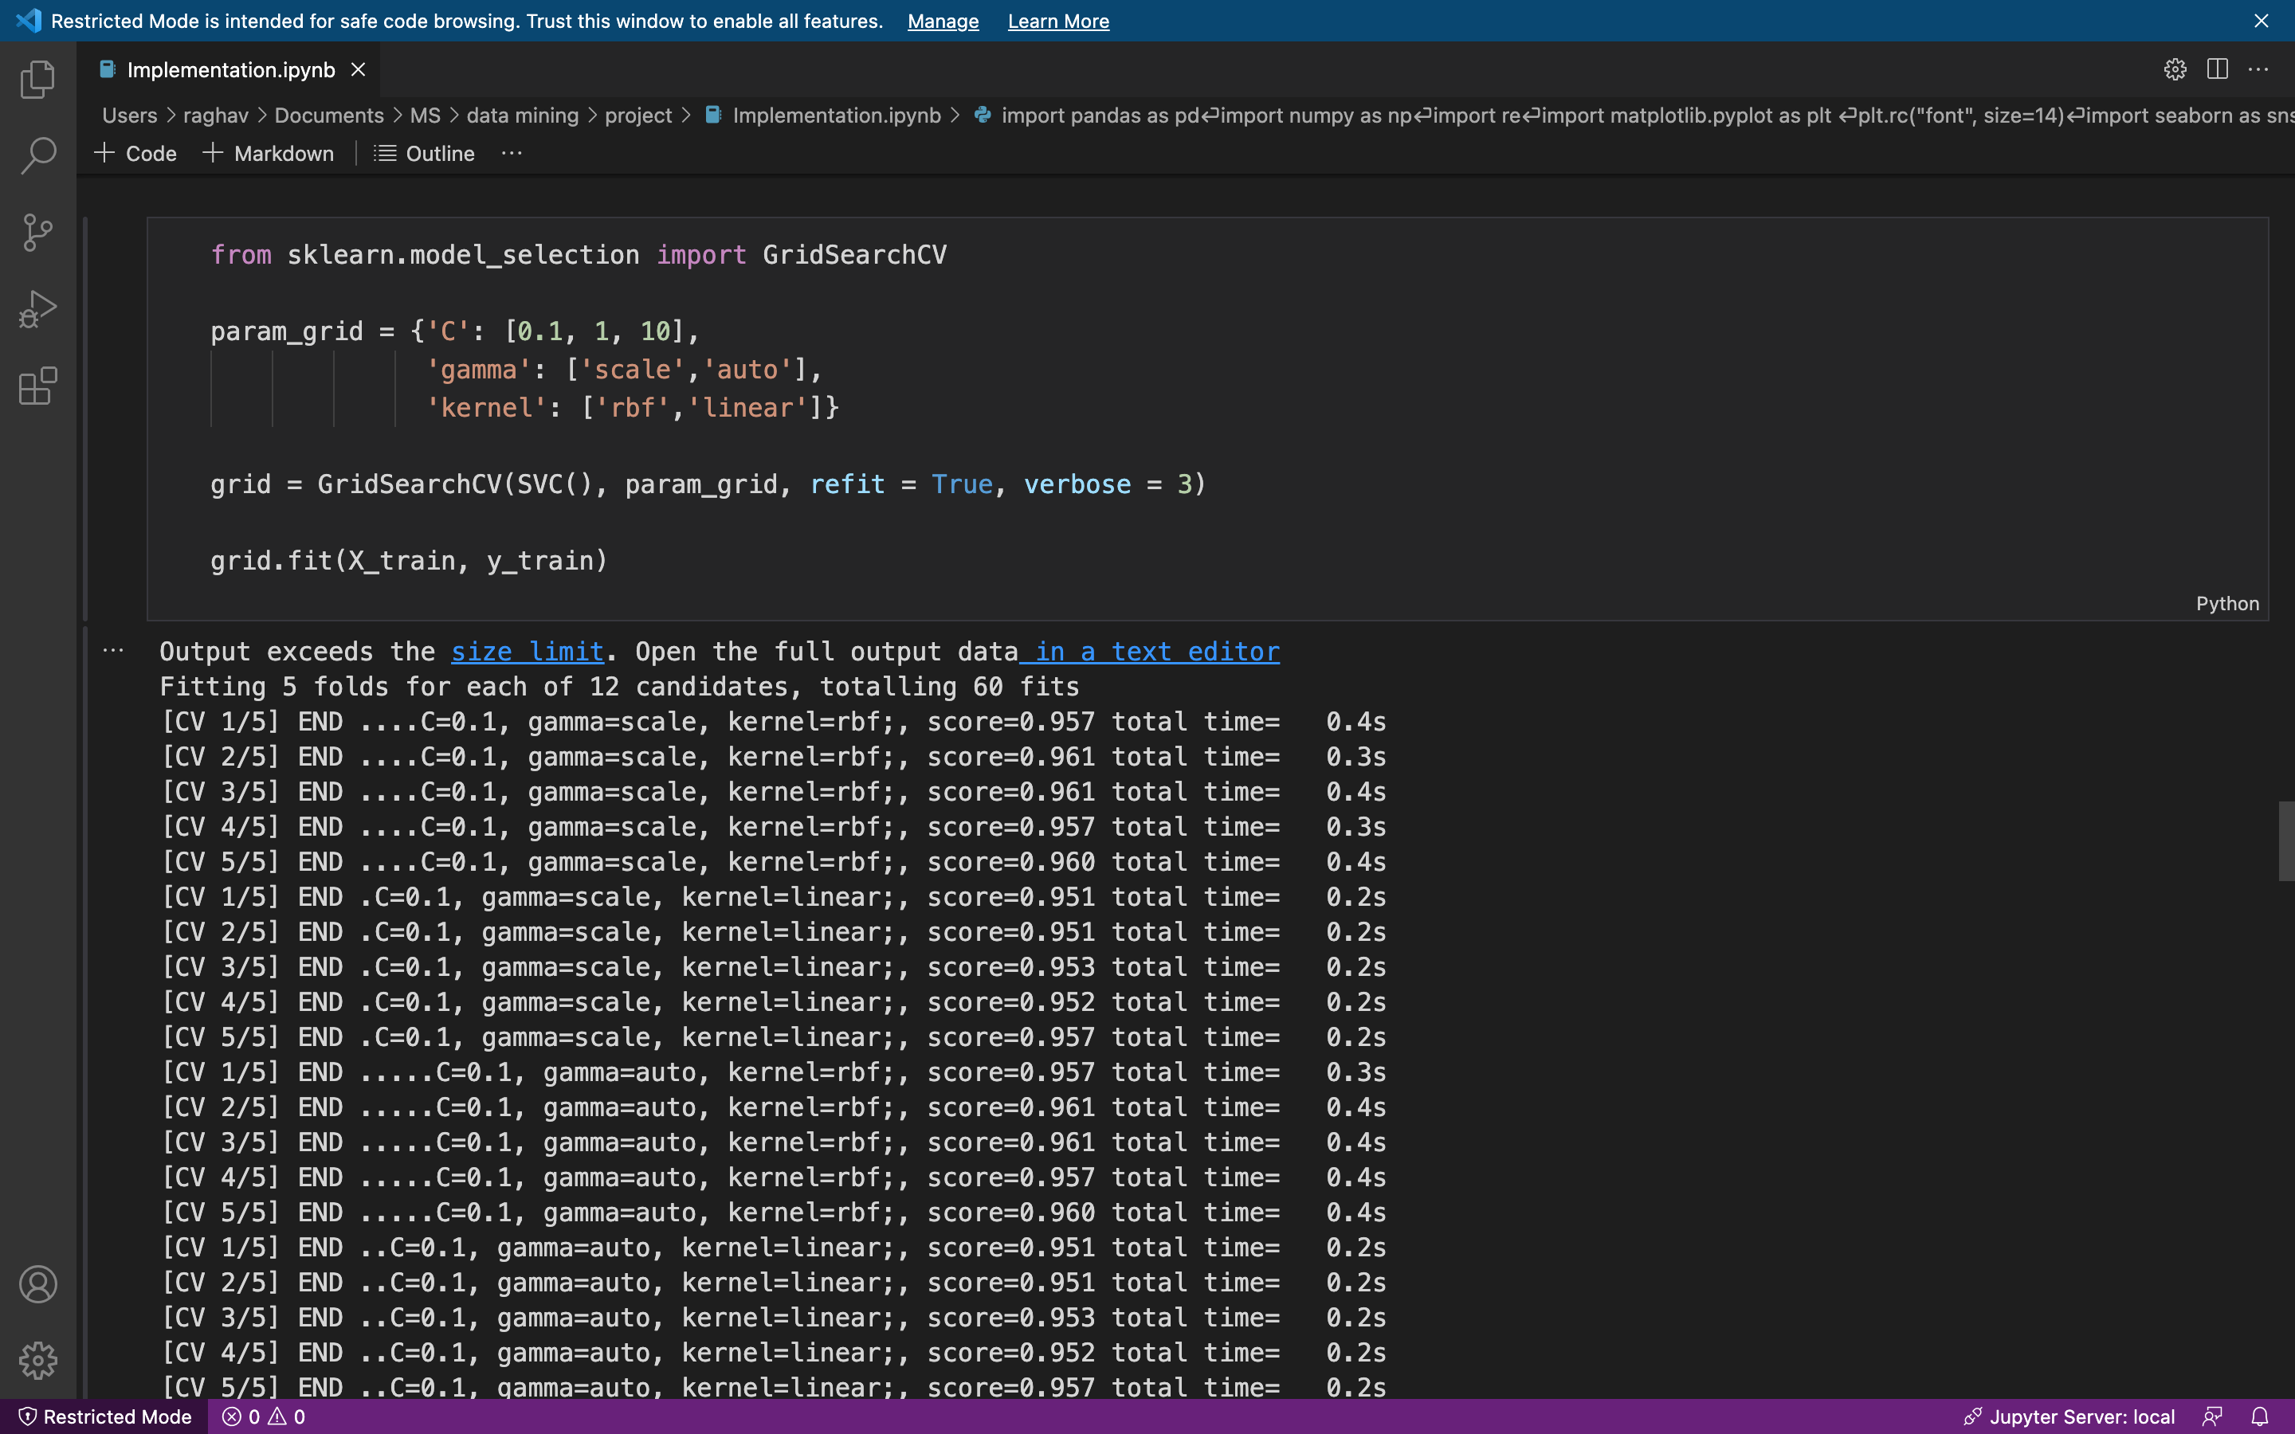
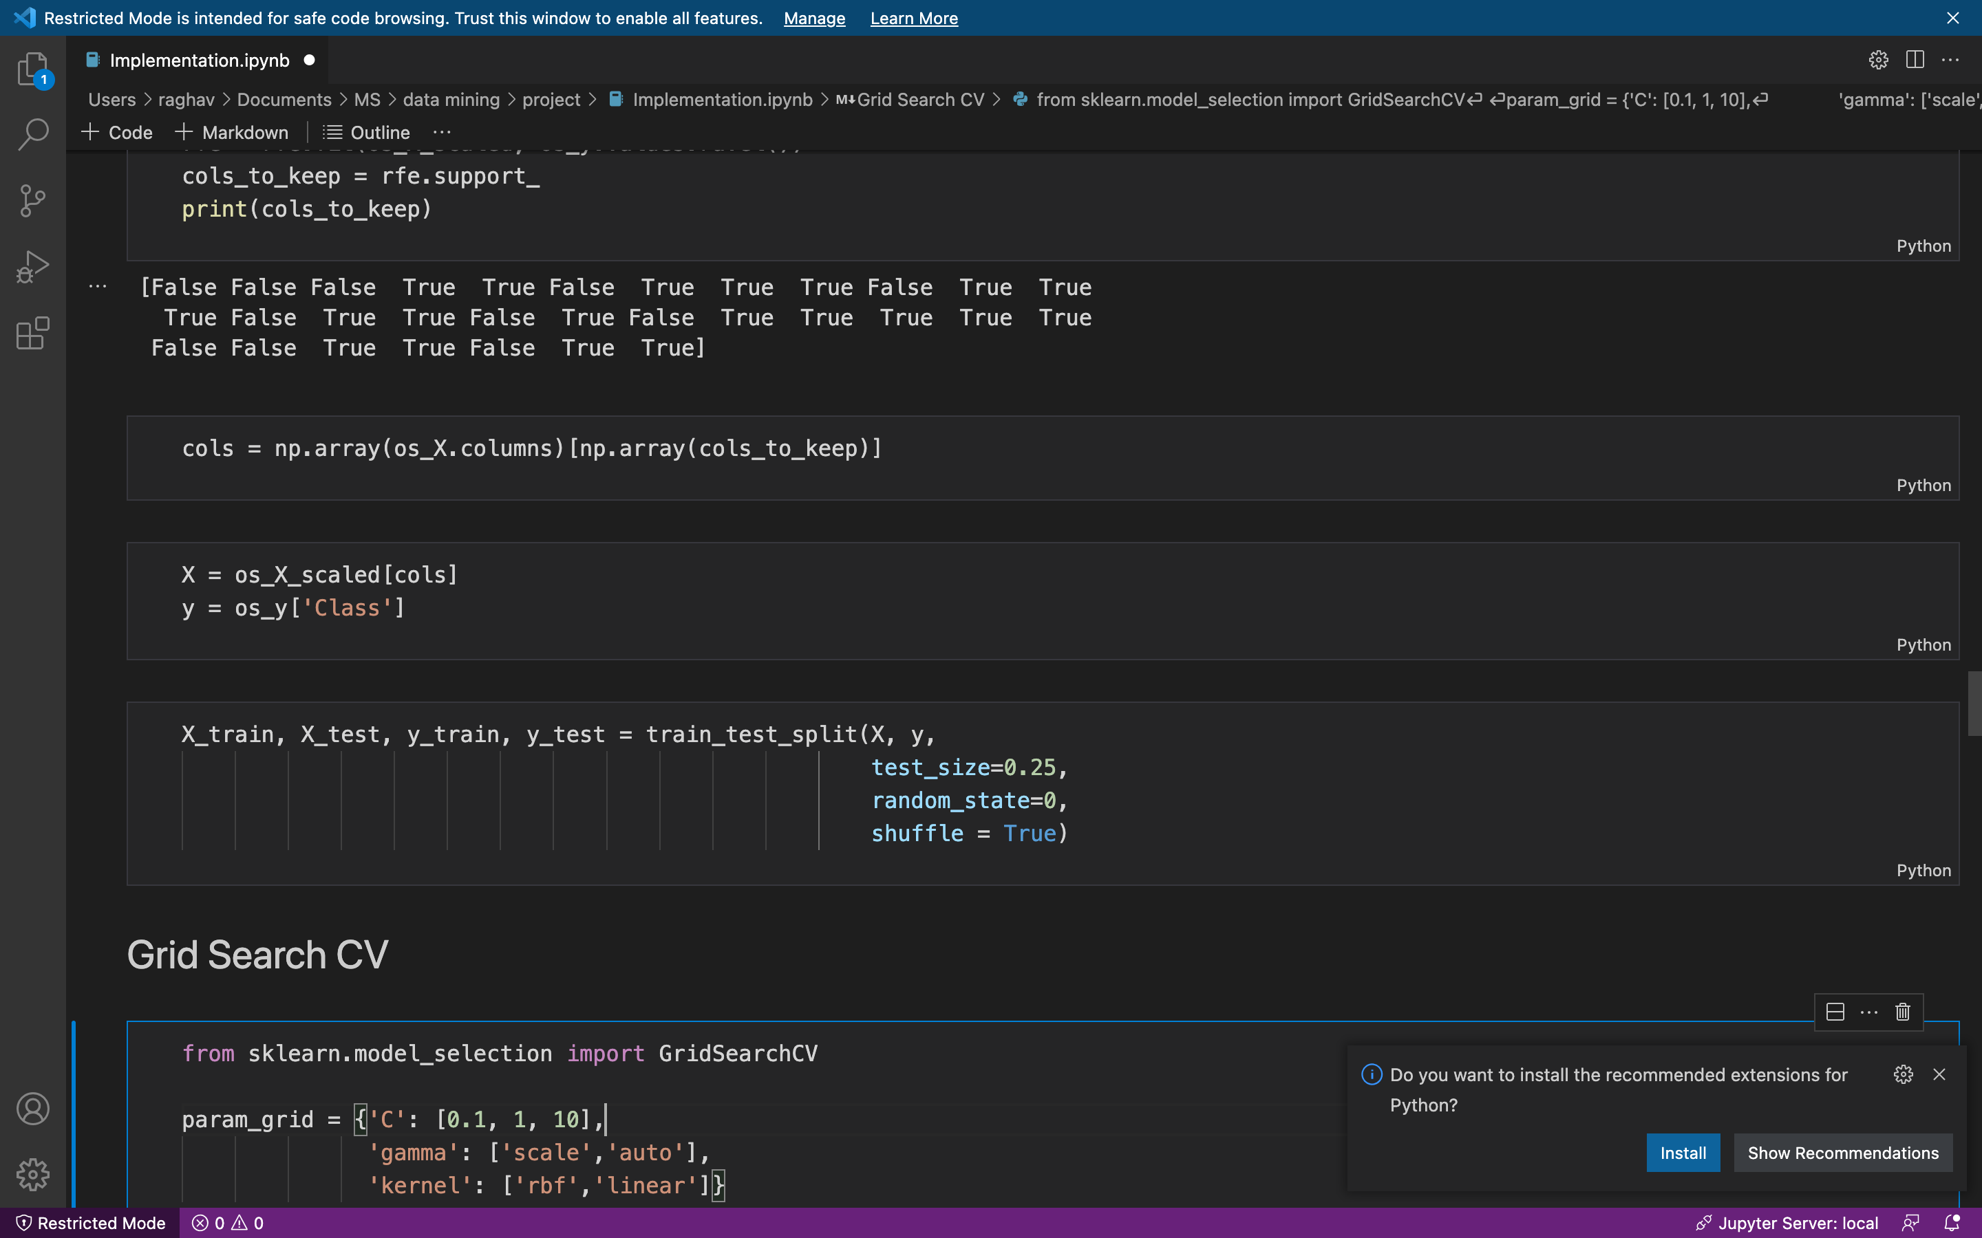
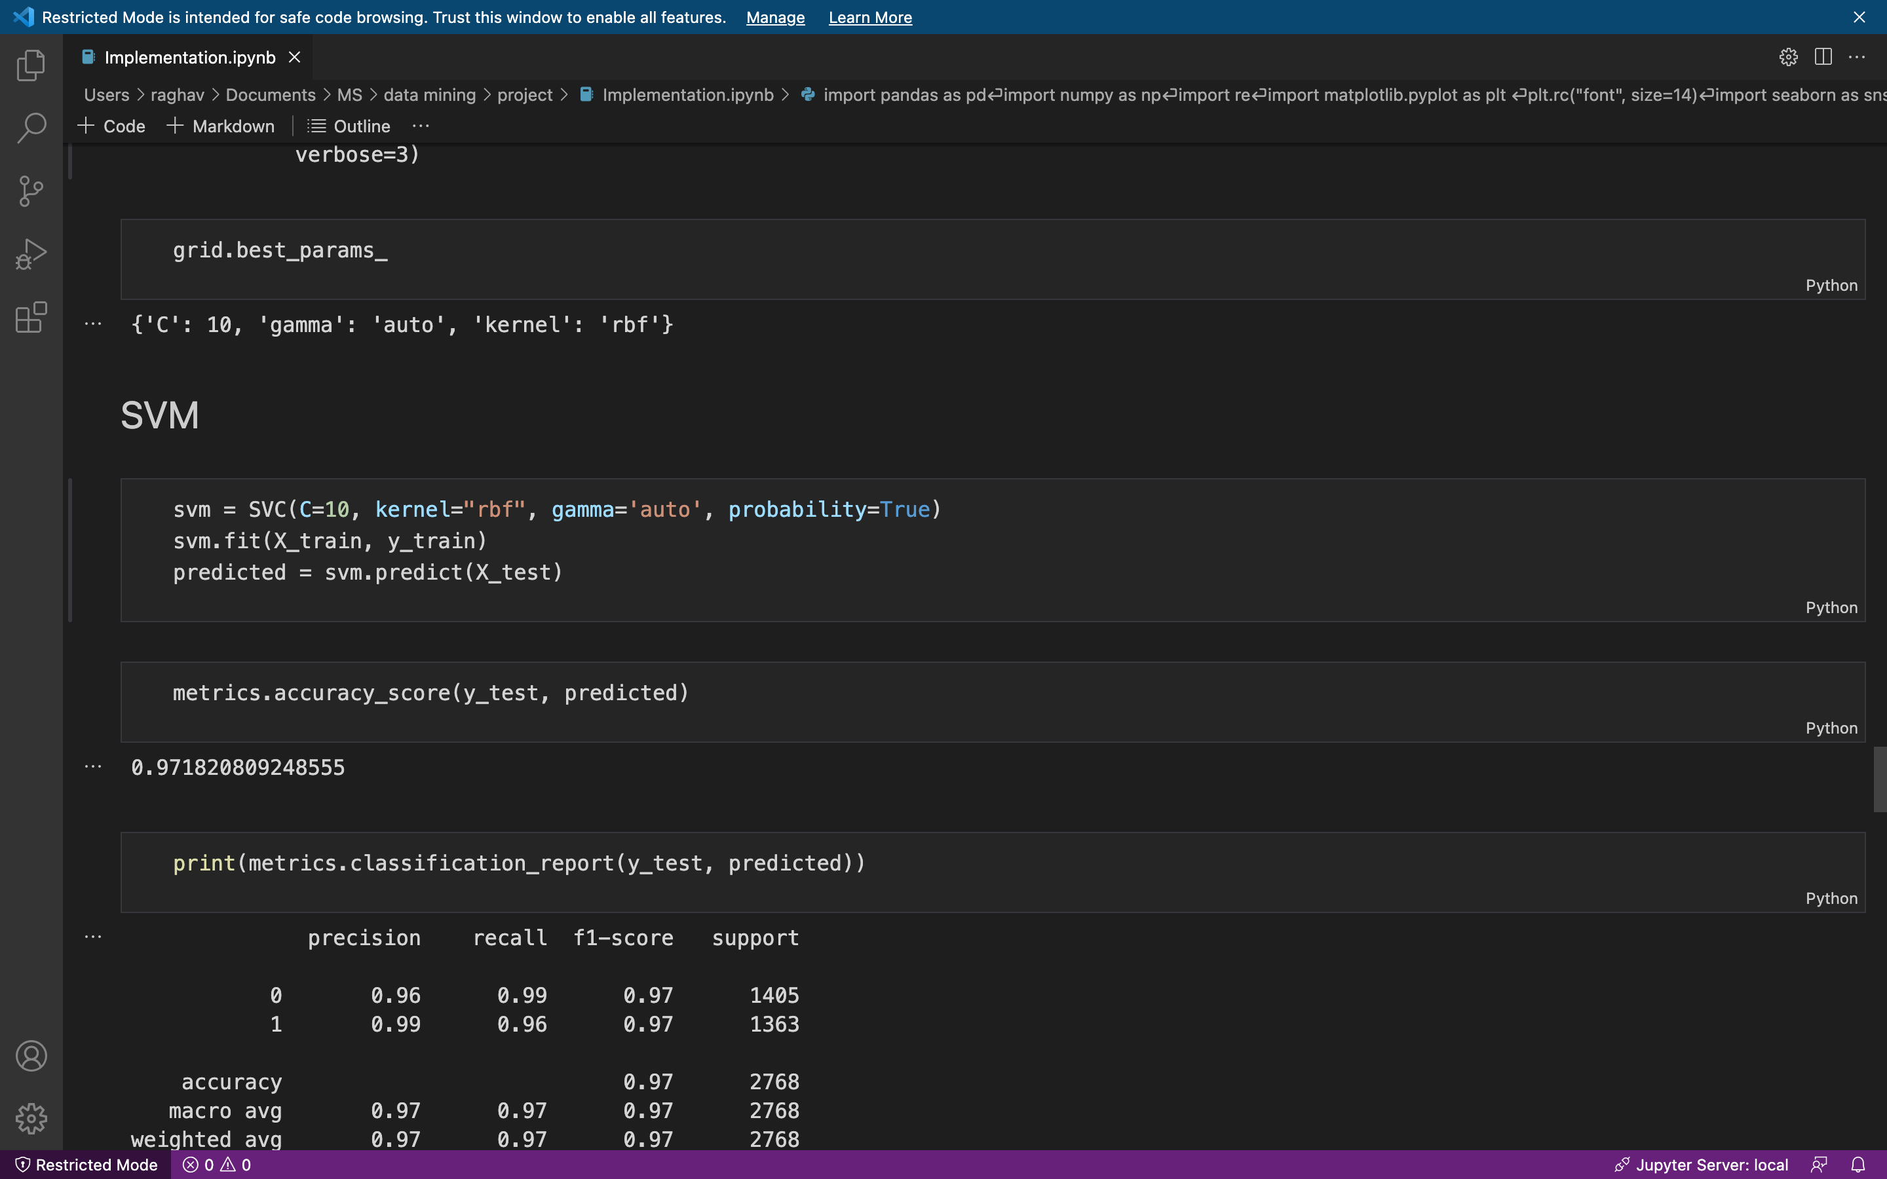
9. Performance Evaluation
9.1. Implementation of Selected Model: SVM
Continued
Applying GridSearch Cross Validation to better tune the hyperparameters of the Support Vector Classifier
08
Converting the Columns in arrays (with NumPy) and then Splitting our data into 25% test size
07
We use Grid Search Cross Validation to find the best hyperparameters for the Support Vector Classifier, inputting a param grid to the cross validator to find the most optimal parameters for our model. The following are out best params:

Slide 17
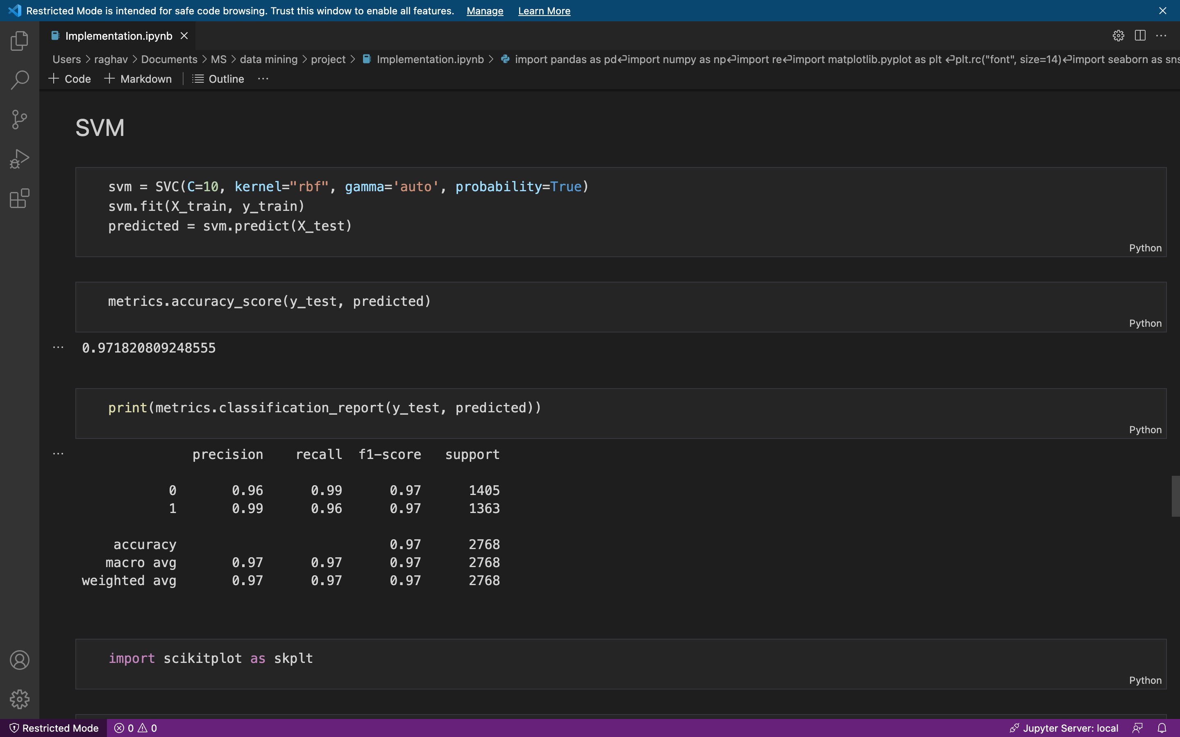
9. Performance Evaluation
9.1. Implementation of Selected Model: SVM
Continued
Model fitting and prediction
09
Lastly applying Supply Vector Classifier to fit our Split data to return the best fit hyperplane dividing it into an accuracy score of
0.971820809248555

Slide 18
9. Performance Evaluation
9.2. Performance Evaluation
Classification Report with y_test and Predicted Values

Slide 19
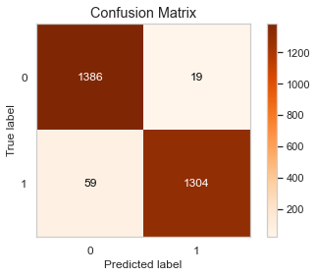
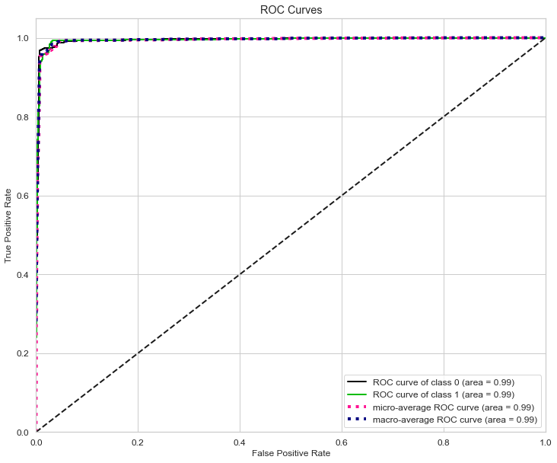
10.1. Insights of Decision Making
Confusion Matrix
01
Interpretation Based on the Predicted Model
The confusion matrix let us analyze how our classification algorithm is doing from our various other classes of data.
02
ROC Curve
ROC Curve defines the random guess model covering 50% area of ROC curve showing the area of class 0 ROC curve as 0.99, area of class 1 ROC Curve as 0.99, area of Micro-average ROC curve as 0.99 and area of macro-average ROC Curve as 0.99

Slide 20
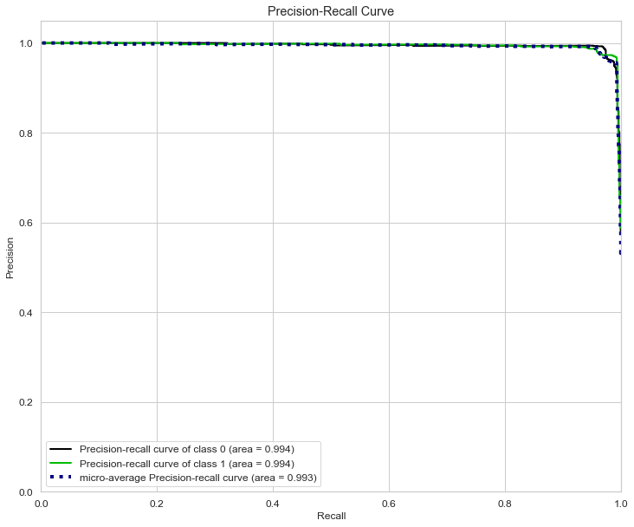
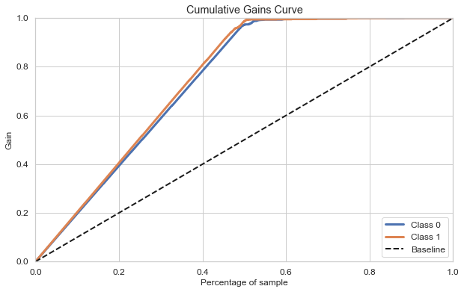
10.2. Insights of Decision Making
Precision-Recall Curve
03
Interpretation Based on the Predicted Model
Target variable ‘Class’ is more than 99% which is good. Therefore, we can assume each class covers more than 95% area so that we can be sure that our model is doing well predicting each class even in an imbalanced dataset situation.
04
Culminative Gains Curve
Percentage of samples in a given category, Class 0 and 1, which were truly predicted by targeting a percentage of the total number of samples, which also means that we took that many percentages of samples from the total percentage that we get from the curve for y-axis are labels which were truly guessed by model from a total number of samples of that class in that many samples. The dashed line in the chart is the baseline curve (random guess model) and our model should perform better than it and both class curves should be above it ideally.

Slide 21
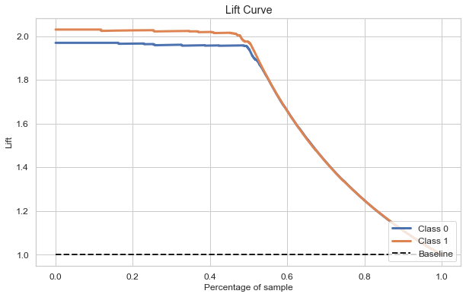
10.3. Insights of Decision Making
Interpretation Based on the Predicted Model
05
Lift Curve
Cumulating the chart by taking a ratio of cumulative gains for each curve to the baseline and showing this ratio on its y-axis.

Slide 22
11. Conclusion, Impact & Future Extensions
Based on the prediction analysis, this project can be used by many multinational companies to check and make it easier for the users to understand different techniques to breakdown malicious vs benign file type.
According to the higher accuracy score, we could analyze how SVM Machine learning model classify different outcomes from target variable Class: Malicious vs Benign with respect to Predictive variables.
THANK YOU!

